Slide 1
Idea & how to present
Be concise (30 min total, time it), slides targeting GA, general audience
More visual, short demo (5 min), informatics/physics/neuroscience fusion
KISS, “If you can’t explain it you don’t understand it” ☺
Start with a quote – ‘Man, learn yourself” © who? End with a smile ☺
Background – 30 years in dev (time to adVenture), resume (university project), fail, CudaCube, epic fail (github), now what?
No AI experience – good or bad? Q. Facts and bits collection and sifting through, ToDo.txt #107, 10 years/30 min, Physarum
Back to basics. What is it? What do we all need? From Physarum to Sapiens. Min efforts -> max result, example #1, from random to 2 spirals, before Physarum!
Genesis (simplified for clarity, add details to extended version?)
Elements, no, elementals. Again, follow neuroscience #104-106. Two types of CMTNs, magic, plasticity. TRK & “growing” (second, etc levels) diagram.
Why no one else can understand it? TED Sebastian Seung, Connectome Project. Analogy – Neanderthal & CPU picture also CPU schema vs Turing machine diagram. “Commonsense psychology” article. “The Devil is in the details”, L Perlovsky
Final pitch. Music. Free for all. Know thyself at the end again w/chatgpt quote & engineering task #108!
“Timing is the key” ©, build from bricks, not sandstone.
Extended version / technical, CMTN timing UML diagram, IO perf. optimization diagram vs training as high level optimization / future design and completeness boundaries (2-3 years), may already be there – GPU CAD, signal modelling systems, MathWorks, Cellular Automata & Mathematica by Wolfram, Adrian Thompson's Hardware Evolution (FPGA), Johnjoe McFadden, Jeff Hawkins. Add all references.

Slide 2

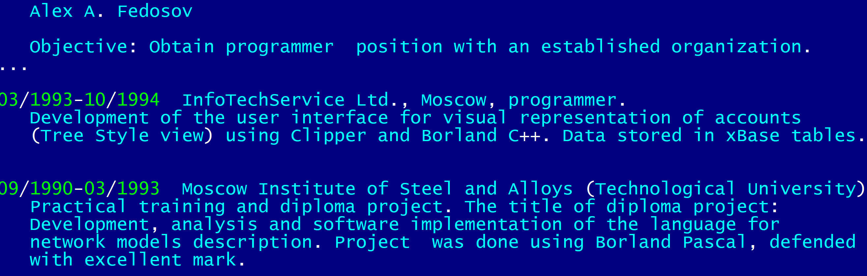
Be honest. Be humble. Be bold. AI and beyond.
Γνῶθι σεαυτόν / Know thyself

Slide 3
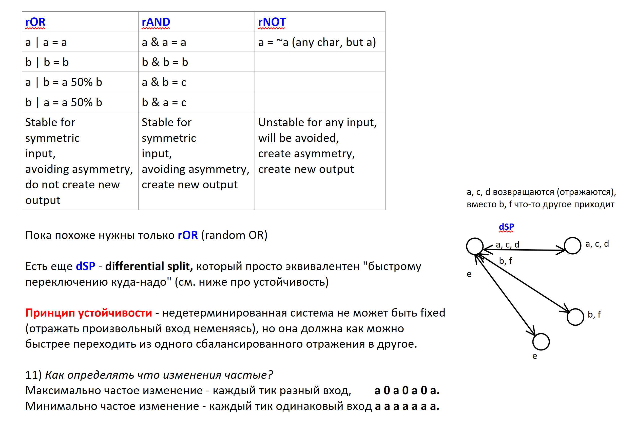
First idea. Implementation. Fail.

Slide 4
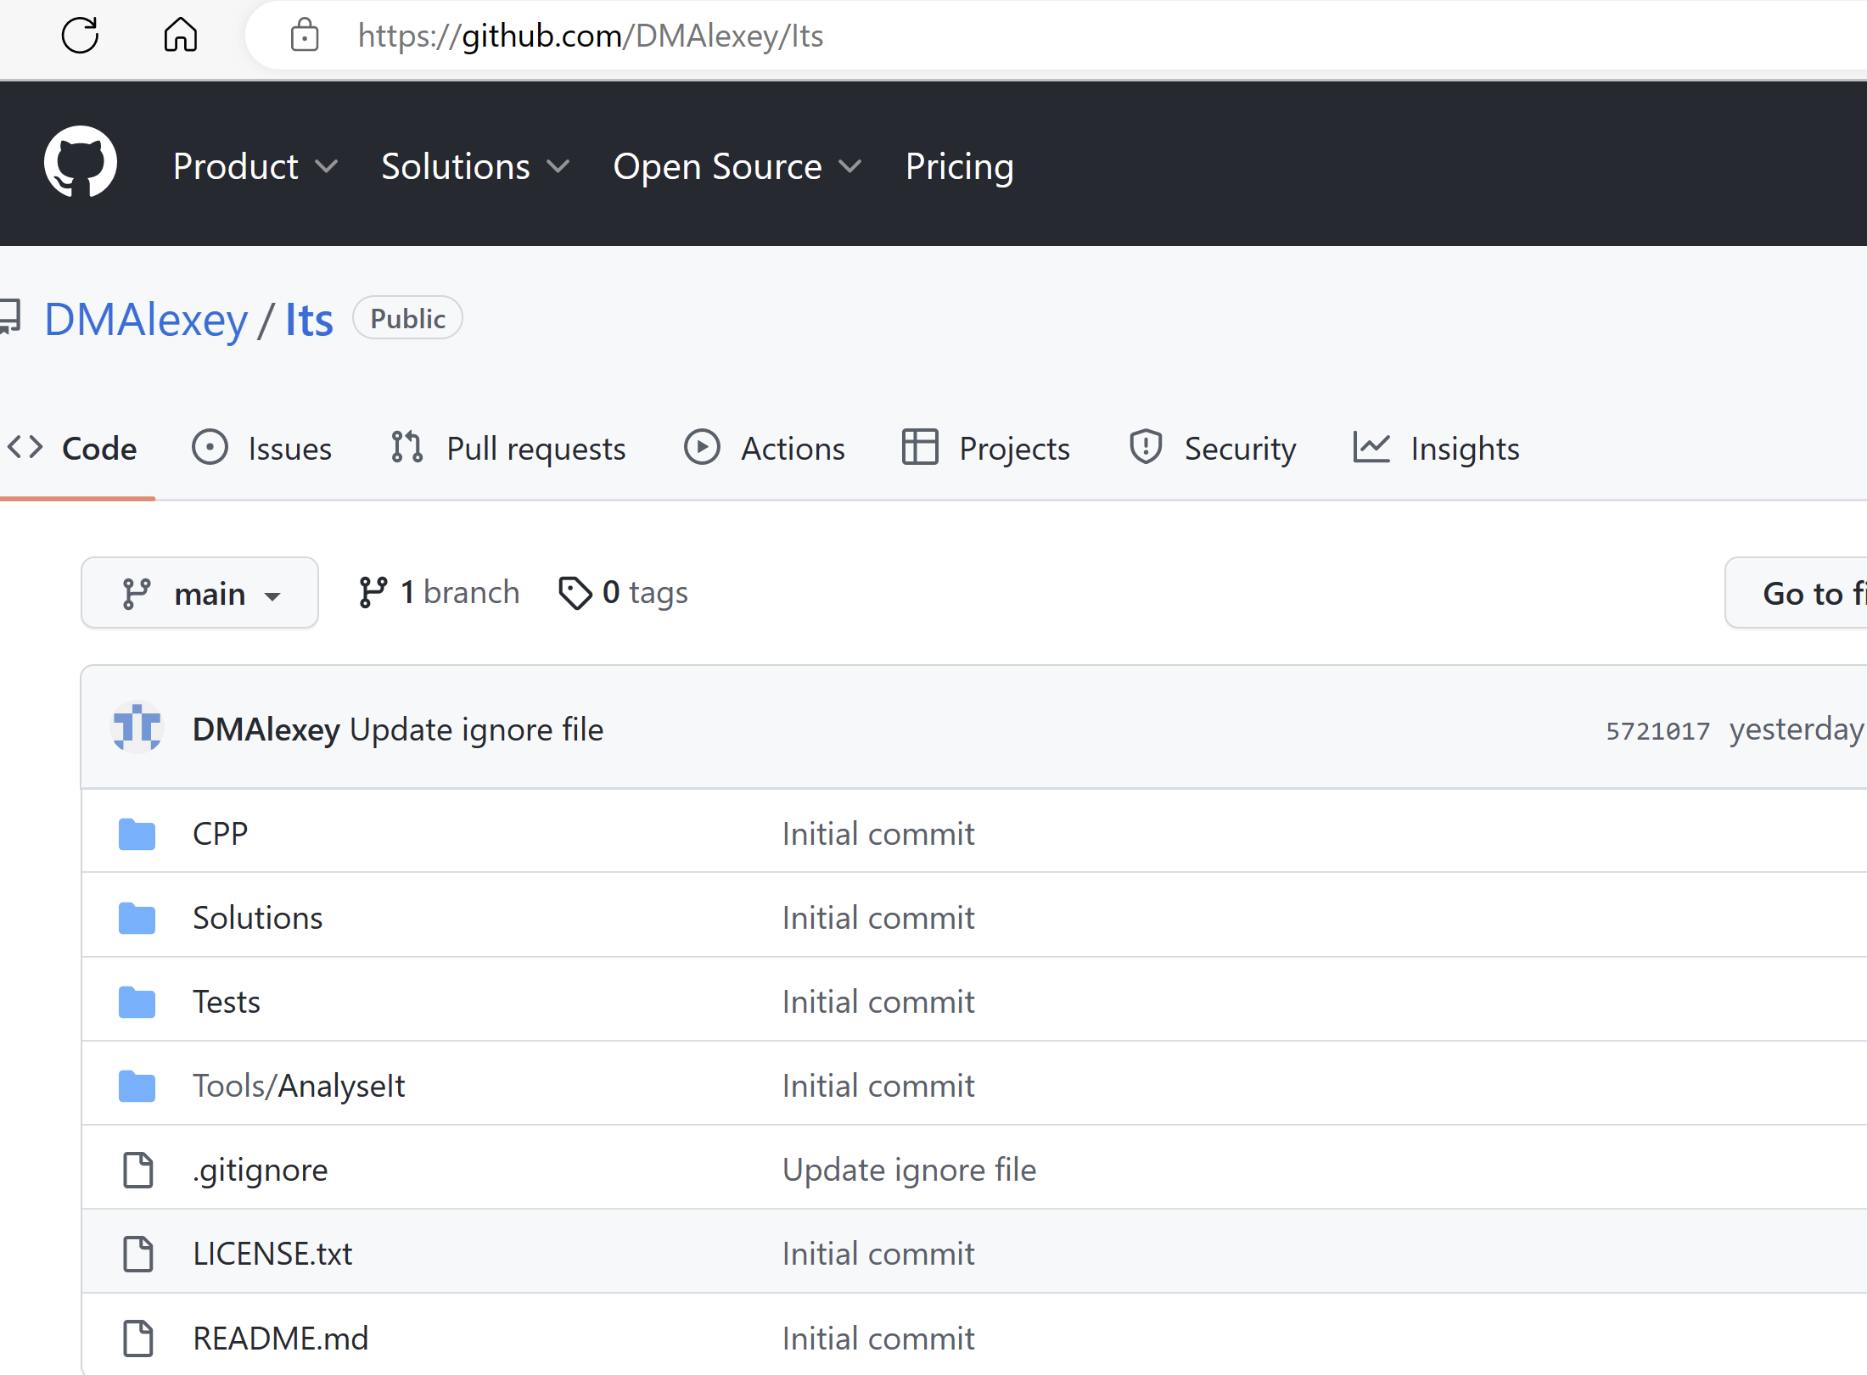
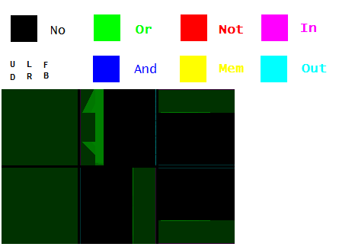
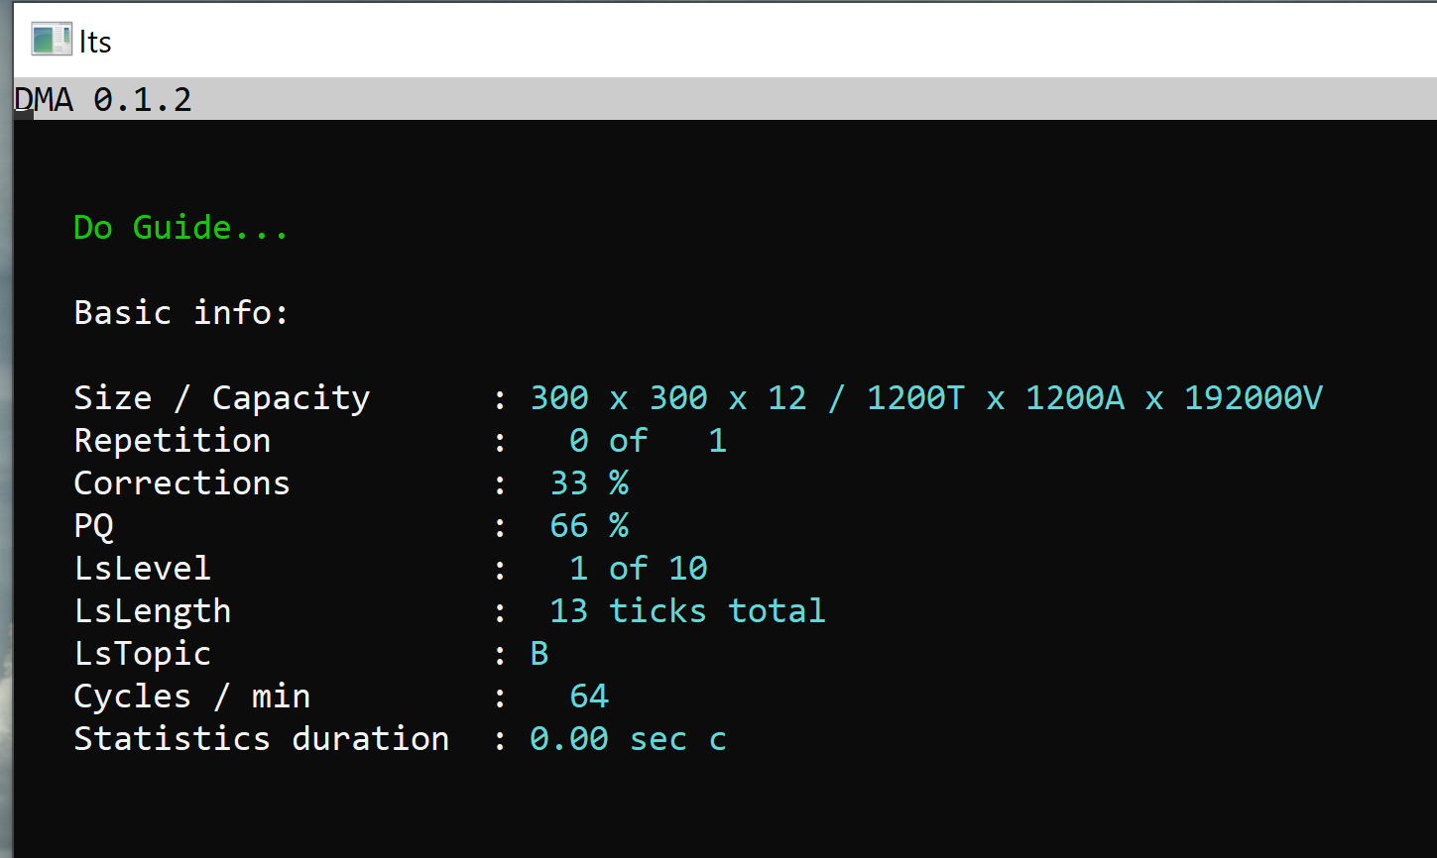
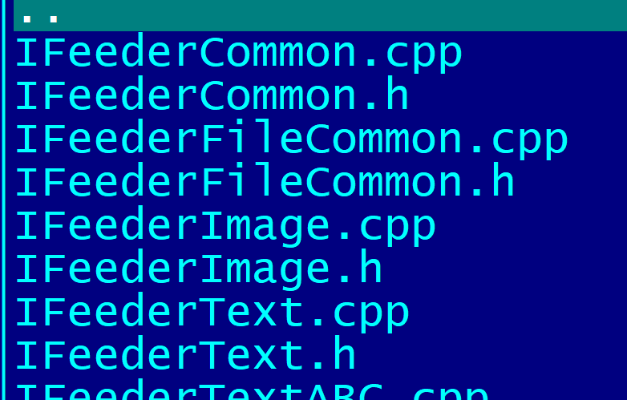
First idea. Implementation. Fail.
The model is powered by Nvidia Cuda SDK / 12 GPU / SIMD
13 projects / 40k LOC / unit testing / demo

Slide 5
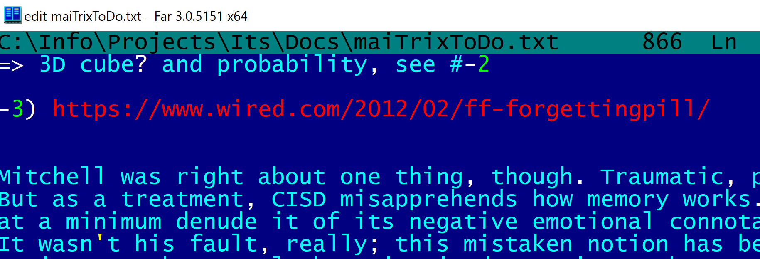
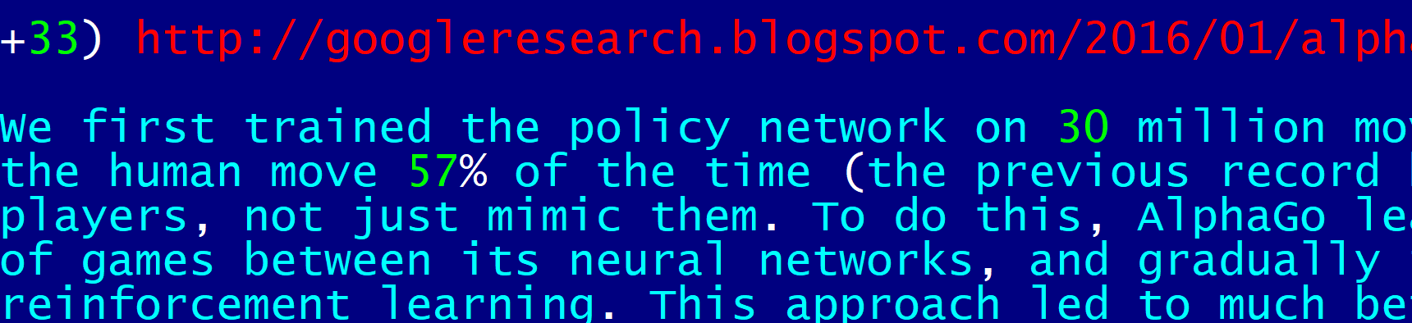
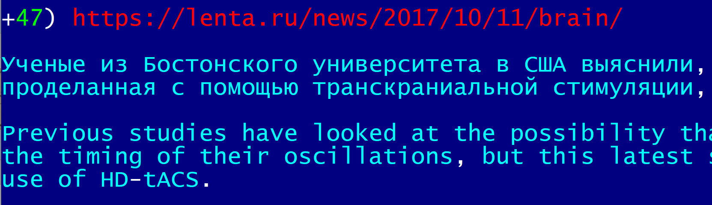
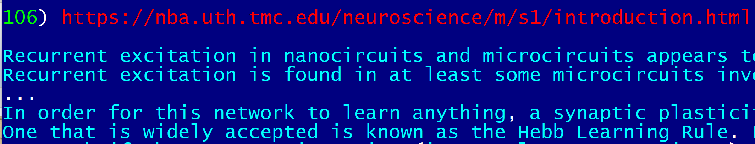
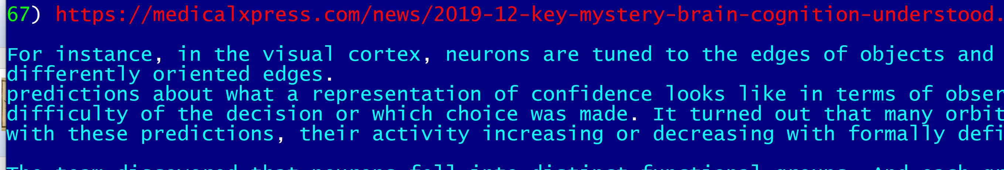
Back to basics. Bits and pieces.
10 years of sifting through facts, models,
white papers, abstracts of academic research papers & Thinking……….. remodeling…… thinking again
No AI experience. Is it good or bad? ;-)

Slide 6

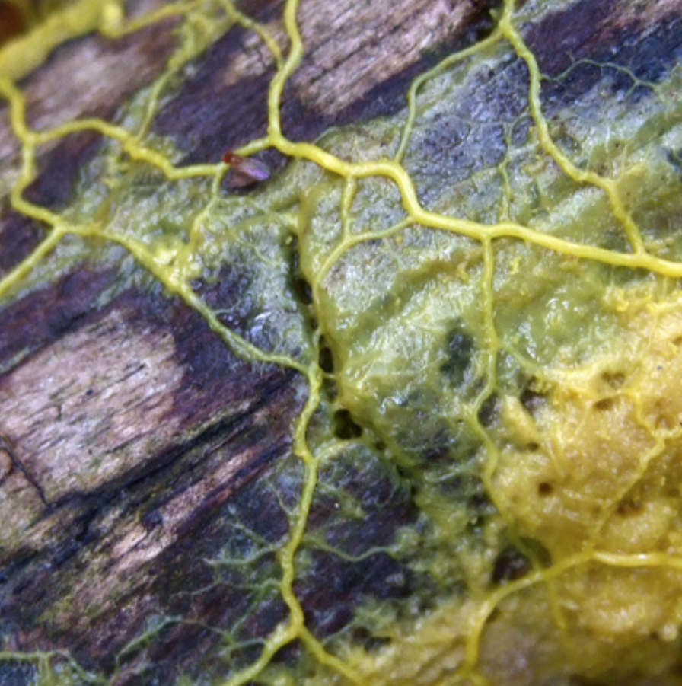
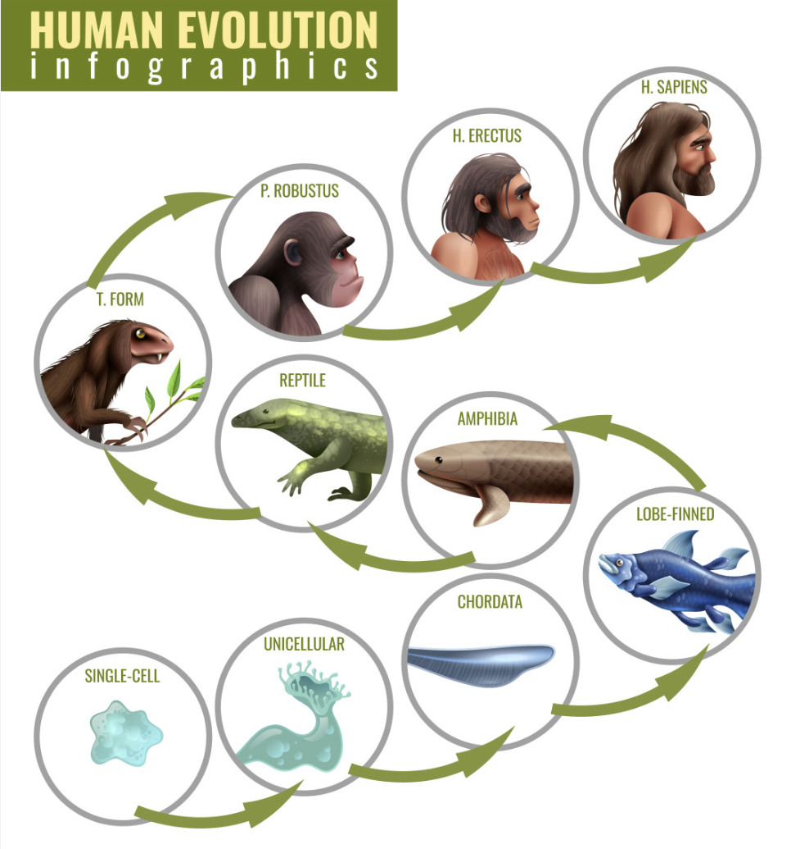
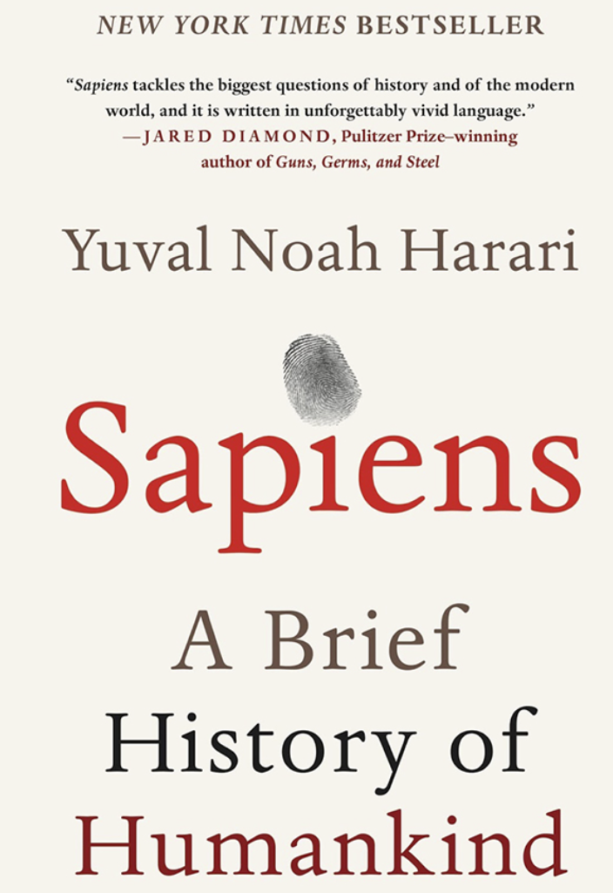
Back to basics. Physarum.
Physarum polycephalum can solve TSP (Travelling salesman problem, NP-hard) in polynomial time.
How?
Min efforts -> Max result

Slide 7
Back to basics. Physarum. How?
Dig deeper. Stage 0. Pre-Physarum.
Random search. Ineffective but works, till now. AI level 0
Min efforts -> Max result

Slide 8
Back to basics. Physarum. How?
Dig deeper. Stage 1. Pre-Physarum. Invertor.
Random search with start/stop. More effective, works anywhere, evolutionary beneficial. Out with 2 speeds, inverted from In. AI level 1
Min efforts -> Max result

Slide 9
Back to basics. Physarum. How?
Dig deeper. Stage 2. Pre-Physarum. Tracking.
Tracking search with start/stop. Super effective, works anywhere. 2 Outs with 2 speeds, inverted from In. AI level 1.5
Min efforts -> Max result

Slide 10
Back to basics. Physarum. How?
Dig deeper. Stage 3. Pre-Physarum. Spiral.
Tracking search with start/stop. 2 Outs with 2 speeds each, inverted from In with 2 controllers, analyzing short and long periods. AI level 2
Min efforts -> Max result

Slide 11
Back to basics. Physarum. How?
Dig deeper. Stage 4. Physarum. Optimization.
Tracking search with start/stop. 2 Outs with 2 speeds each, inverted from 2 Ins with 2 controllers, analyzing short and long periods. AI level - ∞
Min efforts -> Max result

Slide 12
Back to basics. Physarum. How?
Dig deeper. Why spiral is important?
Outward and inward tracking spirals effectively cover 2D surface, approximating food search (TSP) with polynomial time solution. AI level - ∞
Min efforts -> Max result

Slide 13
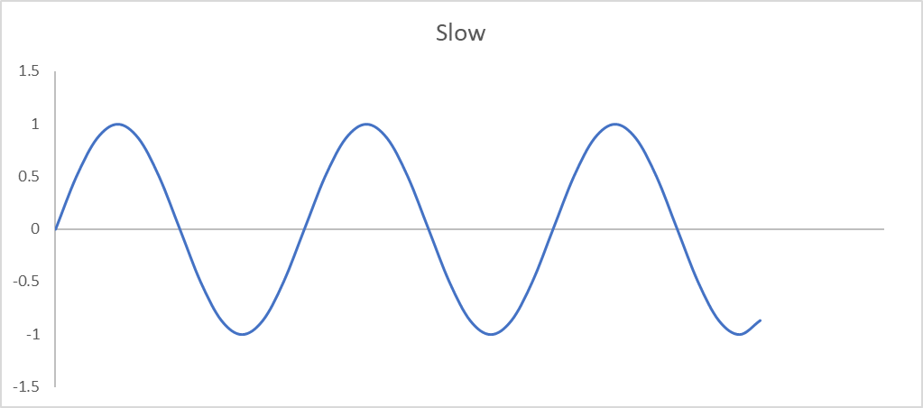
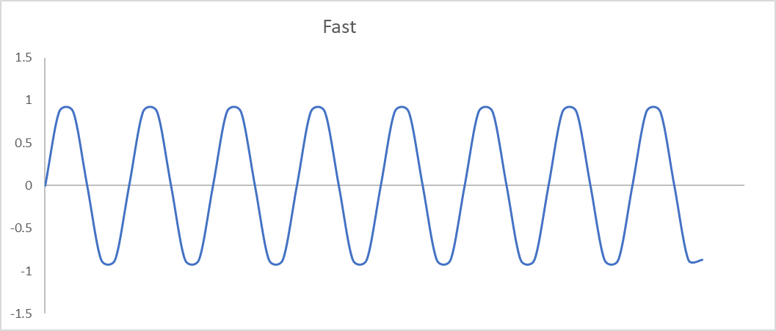
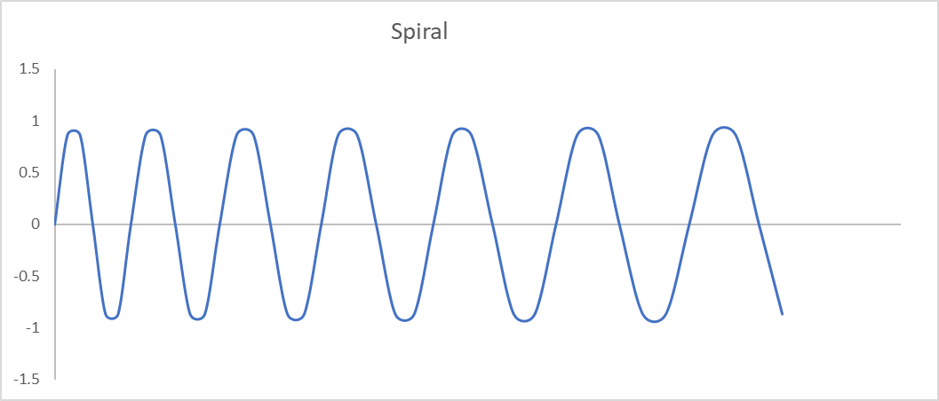
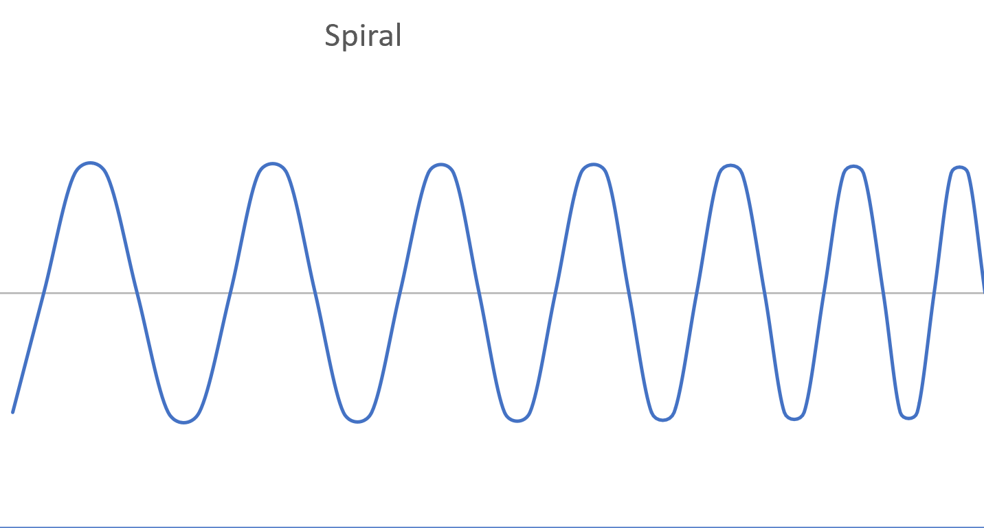
Implementation. Basics.
Invertor Tracking Spiral
Freq F Freq S
Freq LF Freq LS
Freq RF Freq RS
Invertor – slow down when found something;
Tracking - not necessary LF=RF and LS=RS, this is not “spatial inversion”, but similar to Invertor, “temporal inversion” – slow down when found something;
Spiral requires continuous harmonics addition / subtraction;

Slide 14
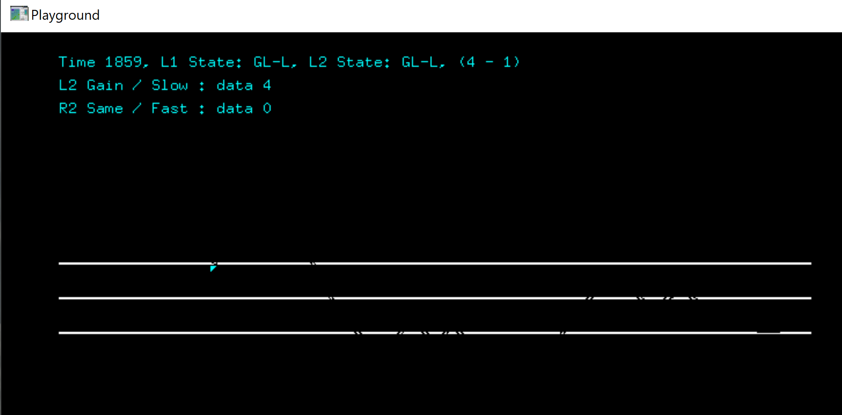
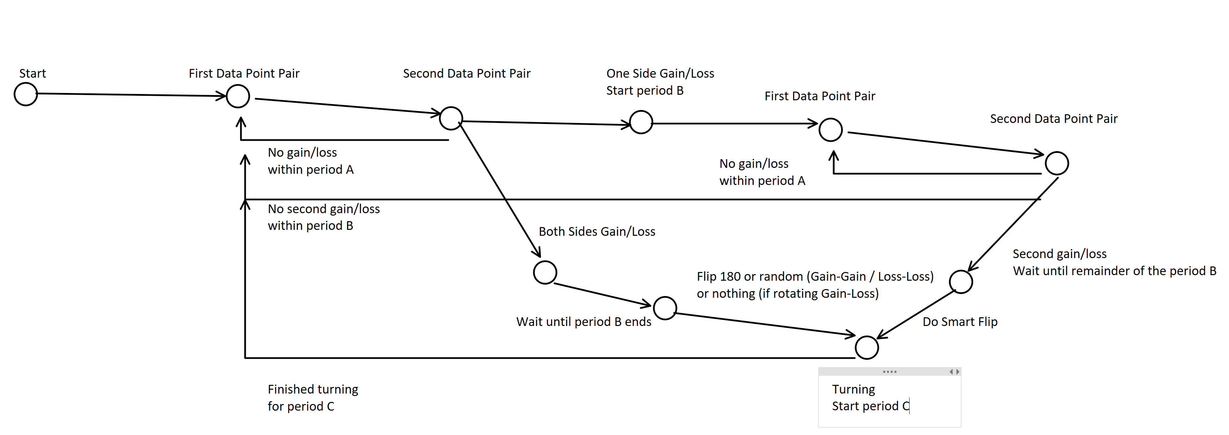
Implementation. Demo.
Tracking with 2nd level, “almost spiral”. Implementation – C++/OpenGL, state machine on both levels, 1k LOC, end-to-end testing.
Hypothesis: Multi-leveled tracking spiral is sufficient solution for the main task on all AI levels “Min efforts -> Max result”, which is NP-hard and beyond.
Question:
Is this elementary implementation? No.

Slide 15
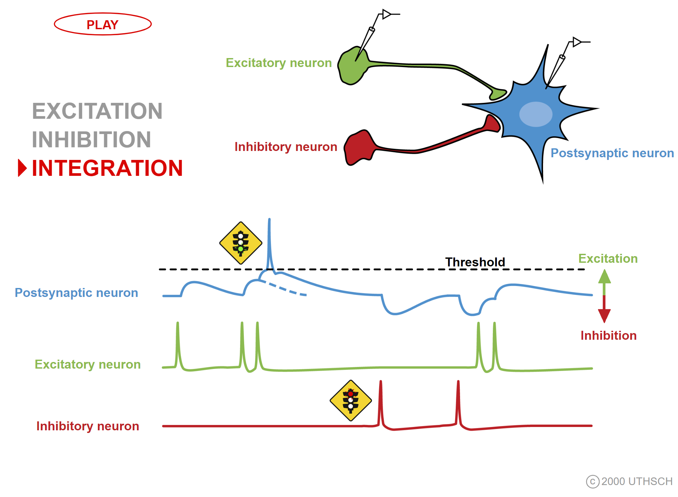

Implementation. Elementals.
(GEN)
Cell
Random search, non-stop
Freq fixed,
few base “tones”
(GEN start/stop)
Cell
Call them GEN too as all generators should be stopped anyway
Freq fixed, start/stop
(INV)
There are a few precise models for neurons;
Feedback delay may vary, affecting frequency but not too much, otherwise it can’t be stopped;
Feedback delay may be != Input delay, thus generation frequency may differ from reaction frequency;
Cell
Smart search, start-stop
Freq inverted

Slide 16
Implementation. Genesis.
In
Out
In
Out1
GEN
GEN
INV
Out2
INV
Better invertor implementation
“Almost tracking”
In
Out1
GEN
Out2
Few interim (evolutional) implementations omitted for simplicity;
Timing is the key;
Not reacting to signals, but to absence of signals within certain period;
Reached Physarum AI level? Maybe!
There’s a catch – won’t work for low frequency signals as “long-long-long delays” are way too costly and we couldn’t stops even if we had it. How to solve?
GEN
Out2
Out1
INV
INV
Tracking,
implementation by duplication,
phase reversed

Slide 17

Implementation. Camertones.
3 bits / sec
(CMTN)
GEN1 freq. 1
In
Out
5 bits / sec
GEN2 freq. 2
Cell
7 bits / sec
GEN3 freq. 3
(1/105) bits / sec
………
(GENS/INVS )
See slide #15, GEN frequency can very, but not much;
Timing is the key, obertones intersection;
Frequencies should not necessarily be prime numbers, but better be pairwise prime;
Think of CMTN as a slow GEN / long delay;
But there’s another use for it, see next slide;
In
Out
CMTN
Cell

Slide 18
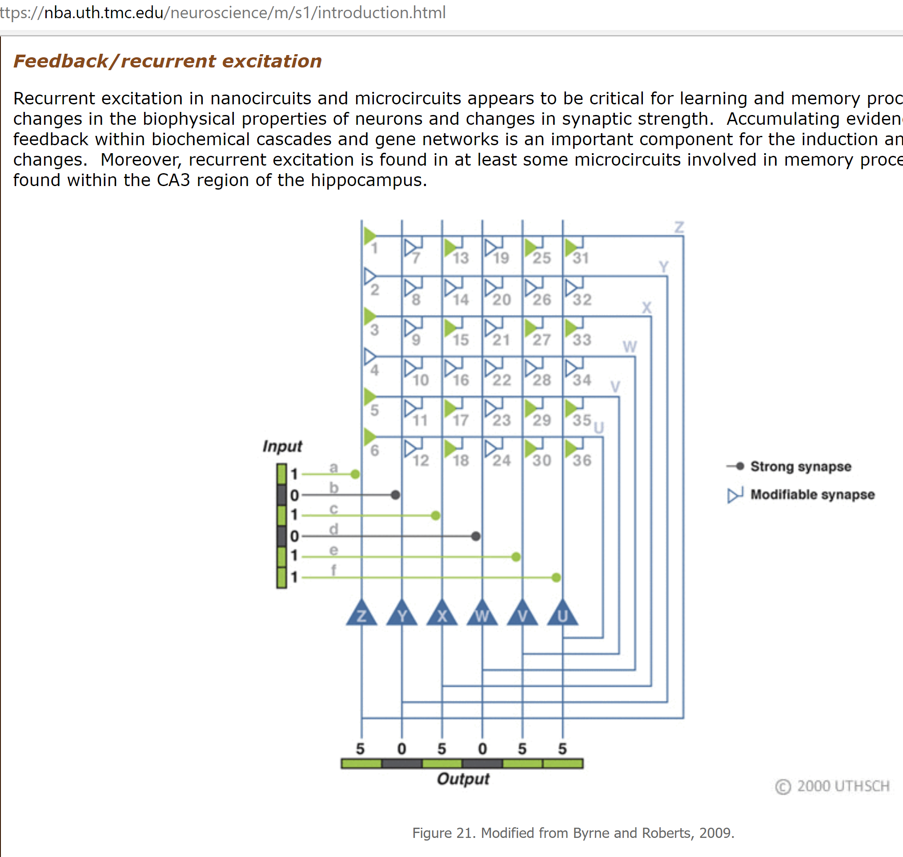
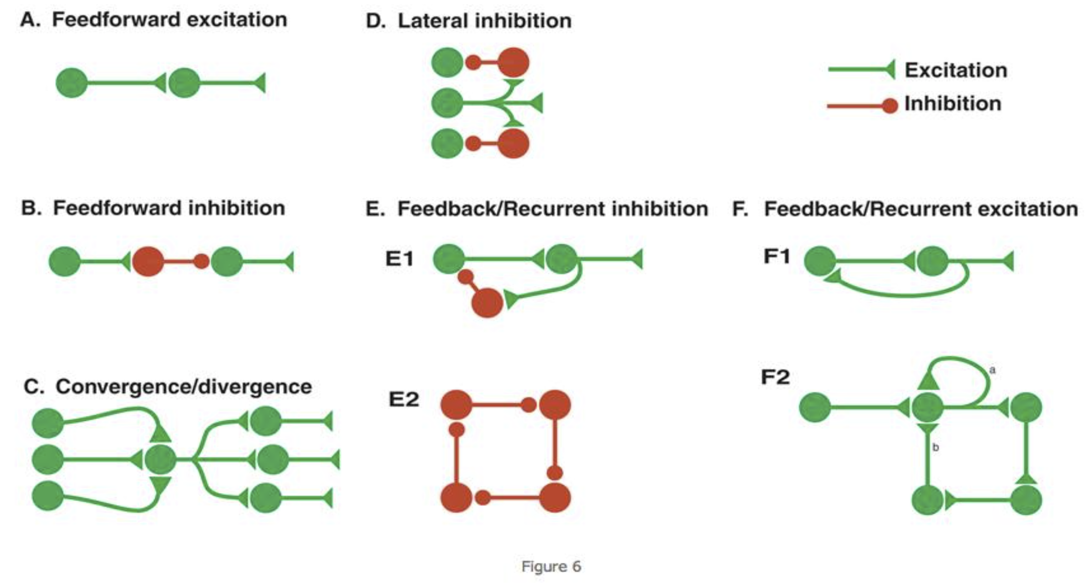
Implementation. Magic.
(GEN)
CMTN can either be slow GEN or slow INV depending on plasticity level:
1
Cell
2
1) GEN when delay ~= refractory period and #1 is prioritized per Hebbian synaptic learning rule (STDP), meaning as we start generation we ignore #2 for the delay period;
In
Out
1
Cell
2
2) INV when delay >> refractory period and #2 is prioritized per Hebbian synaptic learning rule (STDP), meaning we’re restarting generation again and again, ignoring #1 for the delay period;
Cell
1
2
Neuroplasticity (LTP/LTD/STDP),
sAHP, “spike frequency adaptation” Delay & refractory period, time before can be triggered again.
Magic? Music!
Again, timing is the key;

Slide 19
Implementation. Final.
(TRK)
GENS2
Tracker, see slides #13 & 16
works the same way, but speed as slow as required
Phase balancing as required
Out1
GENS1
In
INVS1
Out2
But how do we know what’s required?
Get back to slide #12 and rethink it.
INVS2
INVS2

Slide 20
Implementation. Summary.
Model | Positive | Negative
Algorithmic, traditional Turing design | Very precise and cover wide range of tasks | Require human participation in design and development
ML, deep-learning (CNNs, LSTMs, GANs, SOMs, etc.), too many algorithms exist, meaning no one is a good one | Already mainstream and while not precise but practically suitable for certain applications, domains | Require human participation in design; Models are very complex (>1B variables in the best models); Require training, expensive;
Quantum computing | Suitable for certain applications, domains, under development | Very expensive
Hardware evolution reimaging John H Conway’s “The Game of Life” with FPGA (Adrian Thompson, et al) | “From bottom up” solution, under development | Unknown, under development
Camertones | No training needed, cover all domains, inexpensive | Not validated
CMTN can be slow GEN or slow INV Timing is the key;

Slide 21
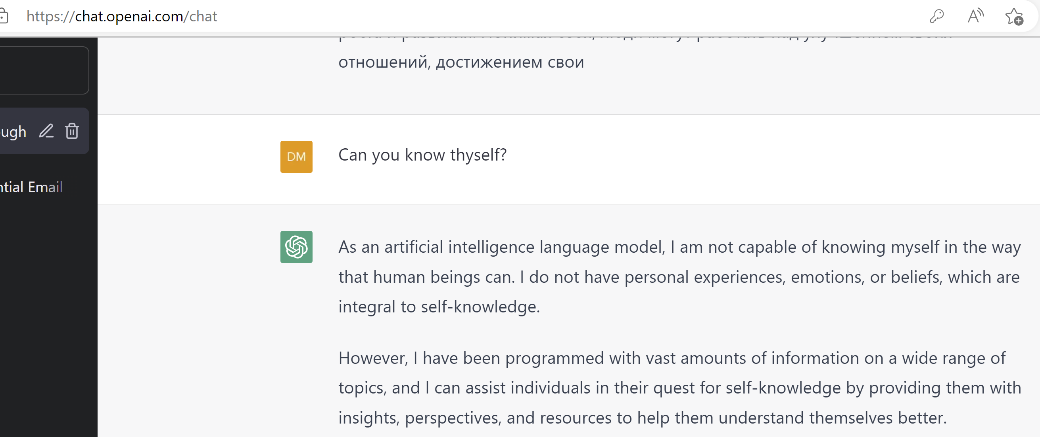
Back to the future
Valid answer. But can we do better than LLM/parrot-fashion models? ;-)
Be honest. Be humble. Be bold.

